Slide 1
Modular Intrusion Prevention System
Presented By:
Rajendra Kumar Nitish Garg
Harshavardhan Chowdary Ellanti
Ravi Sadineni Anshul Anshul

Slide 2
Objective
Monitoring authentication logs
Identifying the failed attempts
Temporarily block the traffic from the corresponding host
Admin console
To manage the block/unblock
To configure the below parameters
Threshold number of login attempts
Blocking period
Time period to monitor the burst of attempts

Slide 3
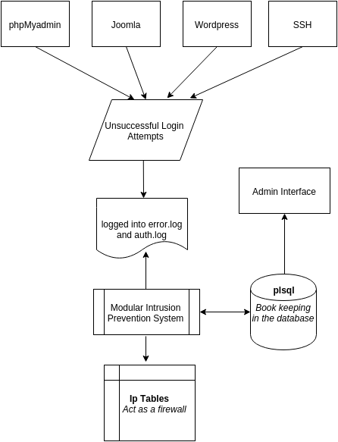
Block Diagram

Slide 4
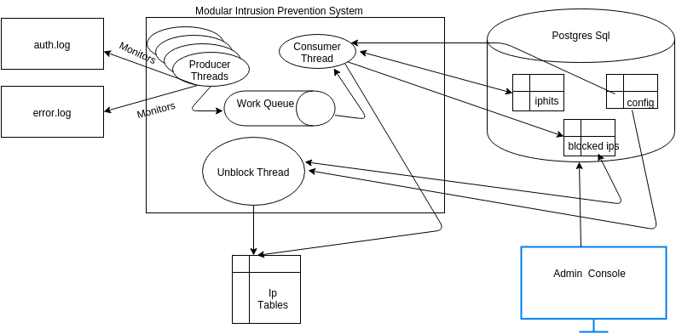
Technical Overview

Slide 5
Modules
Admin Interface
Django Server – runs on port 90
MIPS
Producers
Consumer
Unblock
Postgres SQL
SQL Alchemy
State management
Configuration management

Slide 6
DEMO

Slide 7
Acknowledgements
Thanks to Prof. Nick Nikiforakis for the guidance with the design and implementation suggestions for this project.

Slide 8


